Slide 1

Organization of Several Workstations using 1 System Unit
Spokesperson:

Slide 2
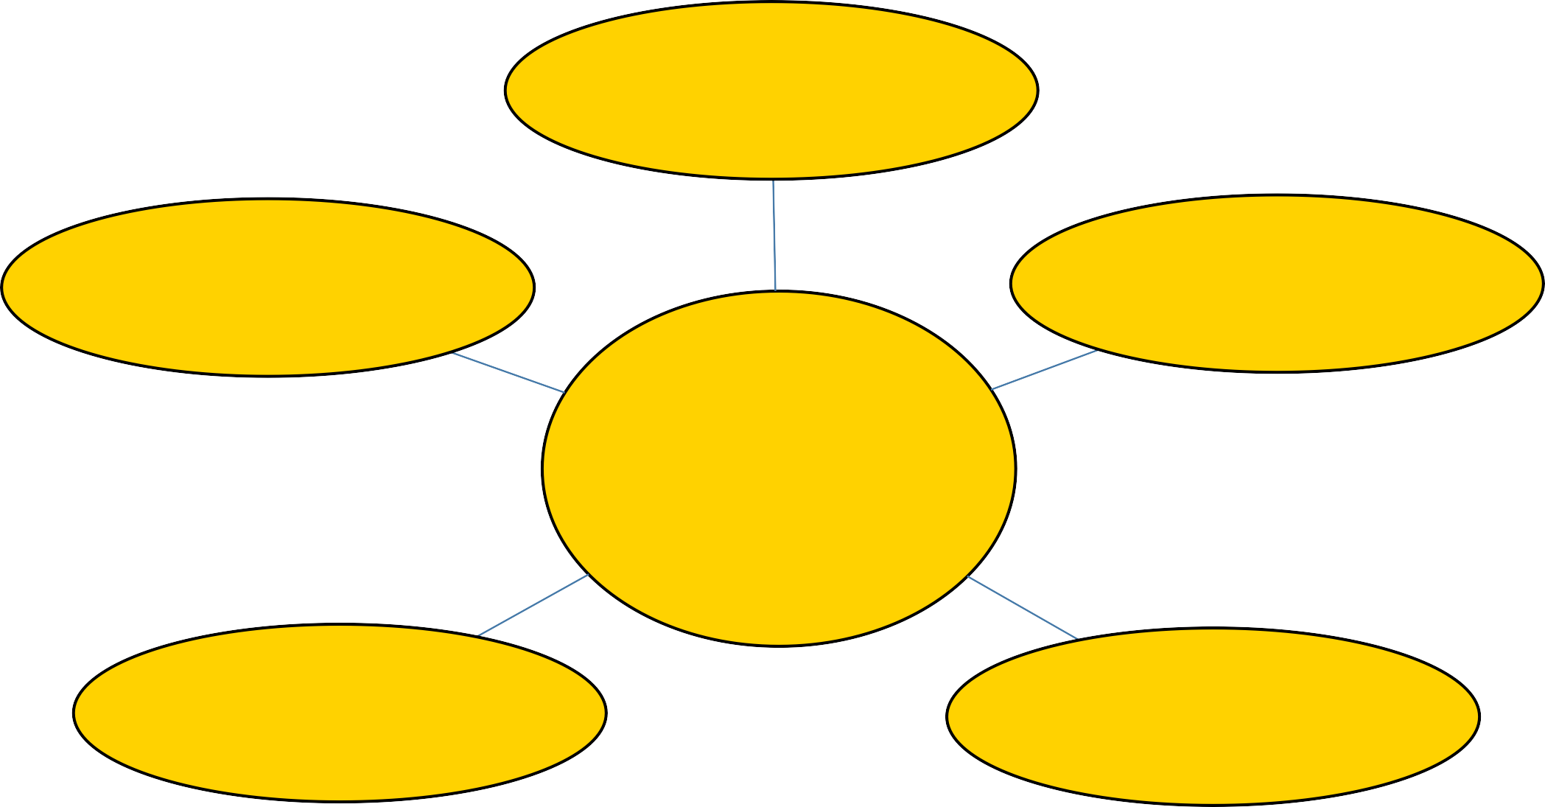
Directions of IT development of JSC “82 SRZ”
Новое
оборудование
New equipment
New automated workstations
Introduction of new software
Directions of IT Development
Направления IT развития
Creation of an ERP system
Transition to electronic document management
2

Slide 3


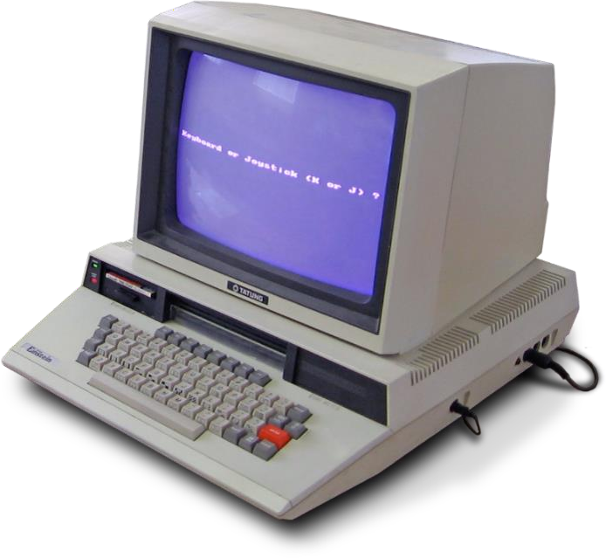

Problems facing the IT department
Lack of budget
Limited time
Moral and physical wear of equipment
Demurrage of technique
3

Slide 4


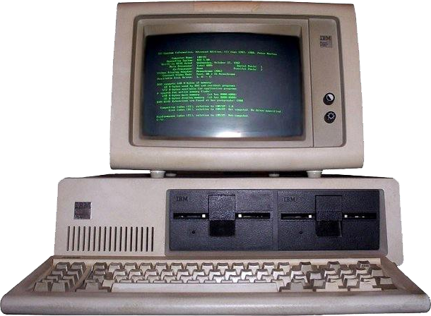
Solution options
Options under consideration
Optimizing the use of system units
Terminal server
Cheap personal computers
4

Slide 5





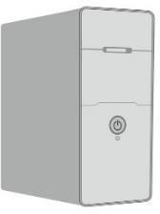


Pilot Project Background

Slide 6
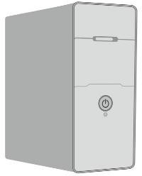
Trial use of the new workstation organization

Slide 7






Software Market Analysis

Slide 8

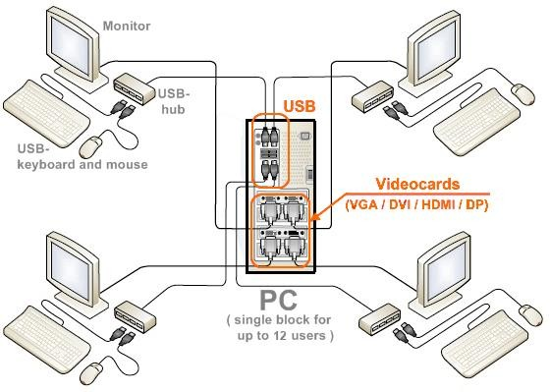
Choosing software for a pilot project
ASTER is a program which allows to create a few workplaces on base of a single PC. ASTER does not use any thin clients and terminal stations.
To create an additional workplace - you just connect 1 more monitor (you can connect to same video card), keyboard and a mouse to your computer (and if it is needed - microphone, speaker, joystick or gamepad). After installing and launching, ASTER will provide each users with its own independent desktop.

Slide 9
Procurement composition for the pilot project
PC specifications:
Processor Intel i3 4th Generation 3,7 GHz;
RAM 8 Gb (DDR3);
Integrated graphics card(HDMI, DVI, VGA);
SSD hard drive120 GB;
Power Supply 450 W;
Monitor 21,5” FHD;
Keyboard;
Mouse;
Software:
Microsoft Windows 7 x64 Professional;
Microsoft Office 2016 Standard;
Antivirus;
Total number of sets – 10. Total cost – 596 100 rubles.
Number of workstations – 10.
It was purchased for the project:
Monitor 21,5” FHD;
Keyboard;
Mouse;
Software ASTER
Total number of sets – 10.
Additional purchase cost– 105 000 rubles.
Total cost – 701 100 rubles. Number of workstations – 20.

Slide 10
The cost of organizing 2 workstations
One-time costs
90 000
82 000
80 000
Economy 40%
70 000
60 000
50 000
49 500
37 220
Economy
40 000
45%
30 000
20 610
20 000
10 000
0
Hardware
Software
Standard scheme
ASTER

Slide 11
The costs of organizing the workplace
70 000
60 000
59 610
59 610
59 610
59 610
59 610
59 610
50 000
41%
57%
63%
40 000
30 000
35 055
20 000
25 528
21 935
20 389
19 211
18 425
10 000
Standard scheme
ASTER
0
2
4
6
8
10
12

Slide 12
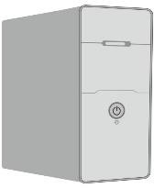
Accommodation option 12 workplaces

Slide 13
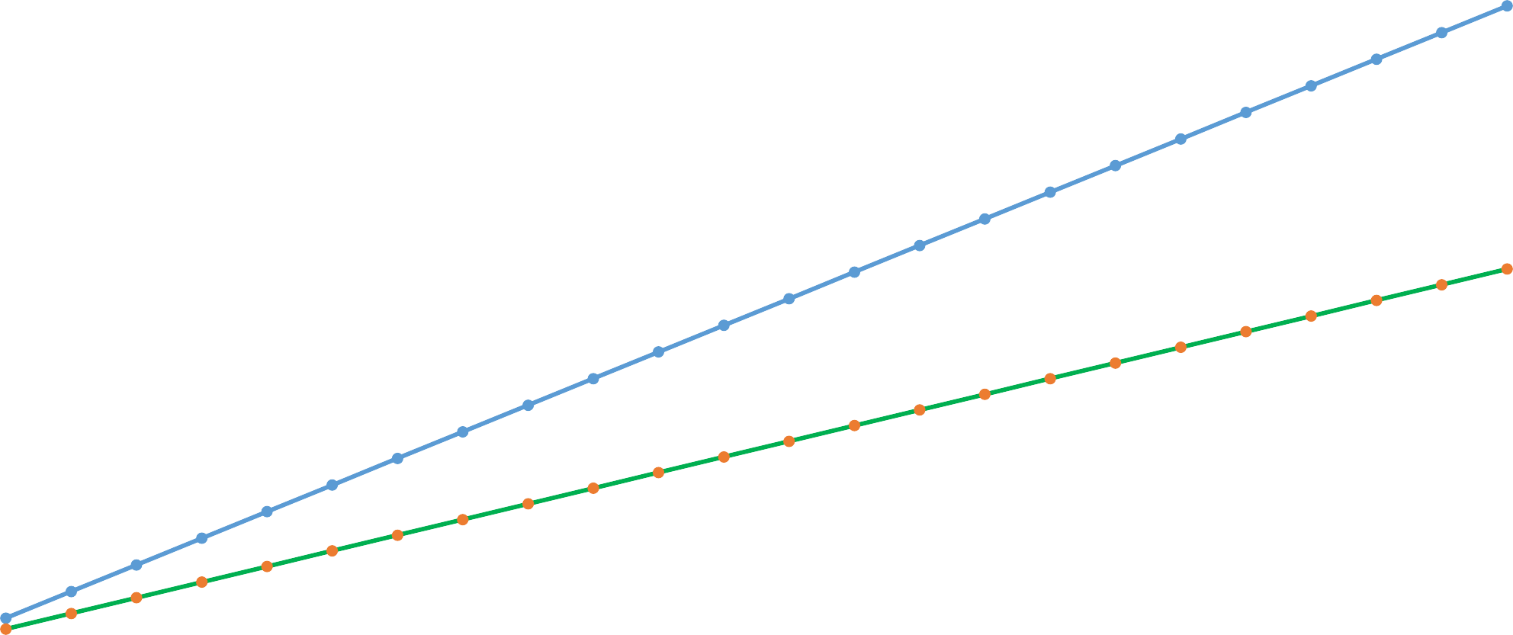
Saving on workplace organization
3 500 000
Standard scheme
ASTER
ASTER on the 12 workstations
3 000 000
2 500 000
1 178 640
2 000 000
982 200
1 500 000
736 650
1 976 880
1 500 000
1 000 000
491 100
1 125 300
500 000
245 550
750 200
0
2 4 6 8 10 12 14 16 18 20 22 24 26 28 30 32 34 36 38 40 42 44 46 48

Slide 14



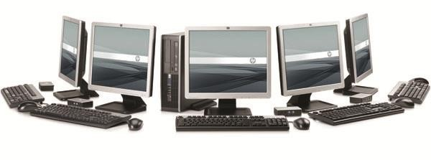
Advantages of using ASTER Software
Reduce equipment downtime
Economy
Ecology
Up to 12 workstations

Slide 15




Disadvantages of using ASTER Software
Remote administration restrictions
PC Prevention
Weak placement flexibility

Slide 16

Conclusion
Based on the results of the pilot project, after analyzing all the advantages and disadvantages of ASTER software, it was decided that it would be advisable to use it in the further organization of new workstations at the enterprise.

Slide 17
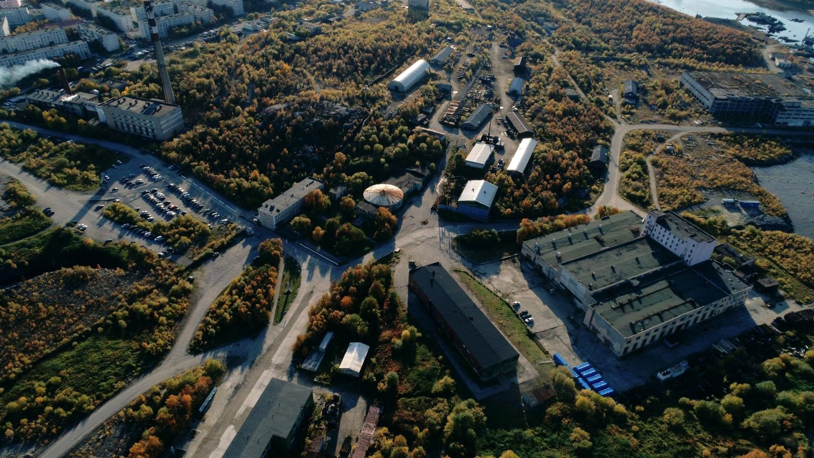
Thank you for your attention!

